Slide 1
ANALOG AND DIGITAL ELECTRONICS
II AIML & BDA
LAB INTRO

Slide 2
EXERCISES:
1. Design and Implement Half and Full Wave Rectifiers using simulation.
2. Design and implement Schmitt trigger using Op-Amp (simulation)
3. Design and implement using simulator a rectangular waveform generator (Op-Amp relaxation oscillator)
4. Design and implement transistor as a switch
5. Design CMOS Inverter, measure propagation delay for rising & falling edge
6. HDL Program to realize delay and stimulus in simple circuit
7. Design and implement code converters using logic gates simulation
8. Design and implement using simulation the combinational circuits
9. HDL program for combinational circuits
10. HDL implementation of Flip-Flop
11. Design and implement using simulation; Synchronous sequential circuits
12. HDL program for Sequential circuits
13. Implement SISO, SIPO, PISO and PIPO shift registers using Flip- flops
14. HDL for Registers and Counters
15. Design and Implement an A/D Converter.

Slide 3
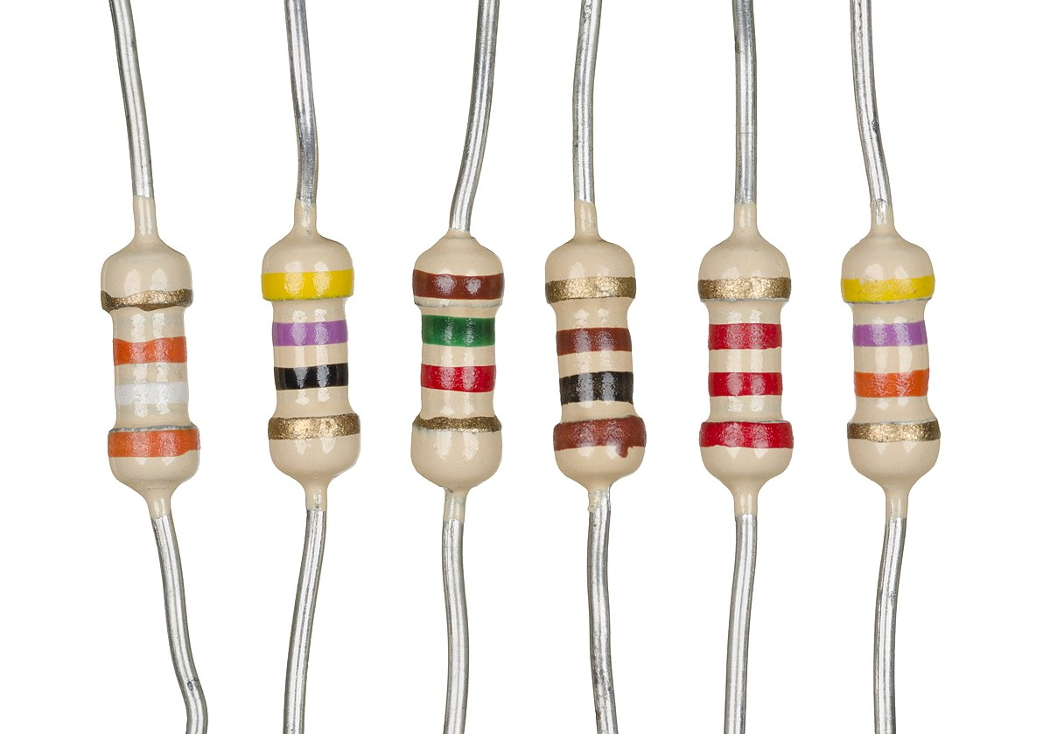
INTRODUCTION - RESISTOR:
A resistor is a passive two-terminal electrical component that implements electrical resistance as a circuit element.
In electronic circuits, resistors are used to reduce current flow, adjust signal levels, to divide voltages, bias active elements, and terminate transmission lines, among other uses.

Slide 4
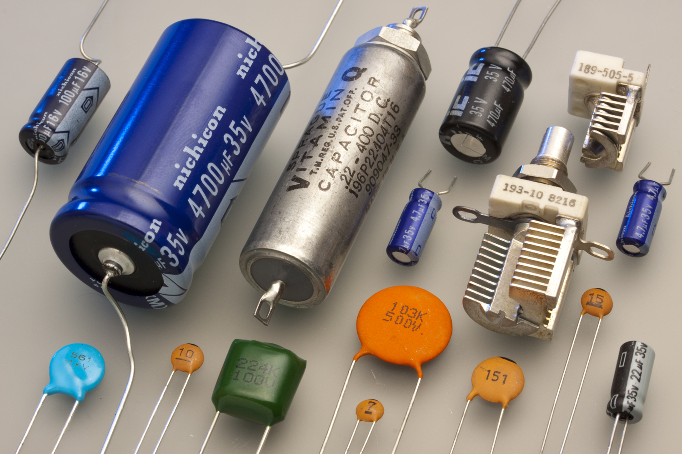
CAPACITOR
A capacitor is a device that stores electrical energy in an electric field. It is a passive electronic component with two terminals.
The effect of a capacitor is known as capacitance.

Slide 5
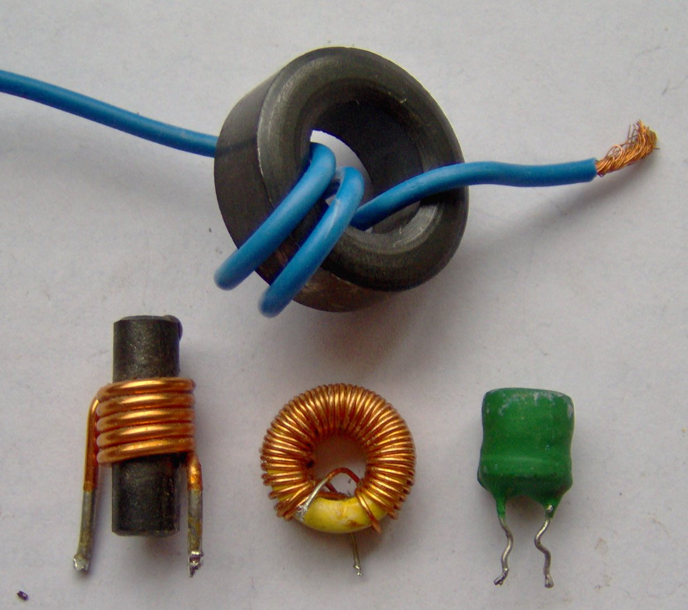
INDUCTOR
An inductor, also called a coil, choke, or reactor, is a passive two-terminal electrical component that stores energy in a magnetic field when electric current flows through it.
An inductor typically consists of an insulated wire wound into a coil.

Slide 6
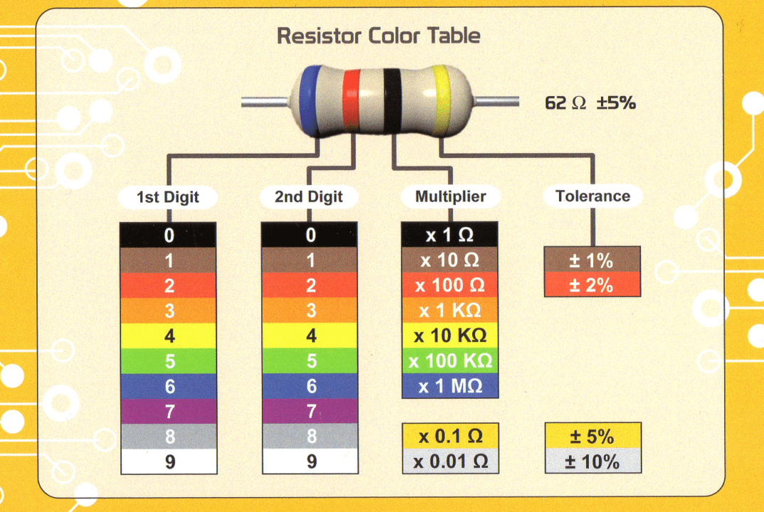
Resistor color coding scheme

Slide 7
Exp. 1: Design and Implement Half and Full Wave Rectifiers using simulation.
Rectifier:
A rectifier is a device that converts alternating current (AC) to direct current (DC), a process known as rectification. Rectifiers are essentially of two types –
a half wave rectifier and
a full wave rectifier.
Half Wave Rectifier:
On the positive cycle the diode is forward biased and on the negative cycle the diode is reverse biased. By using a diode we have converted an AC source into a pulsating DC source.
In summary we have ‘rectified’ the AC signal.

Slide 8
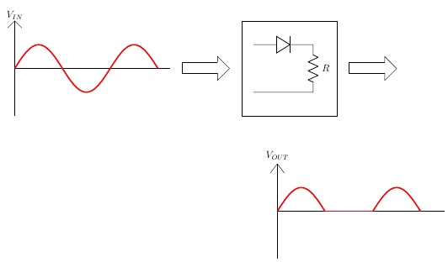
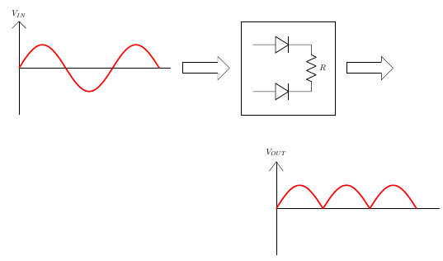
Exp. 1: Design and Implement Half and Full Wave Rectifiers using simulation.
Full Wave Rectifier:
A full-wave rectifier is exactly the same as the half-wave, but allows unidirectional current through the load during the entire sinusoidal cycle (as opposed to only half the cycle in the half-wave).
A full-wave rectifier converts the whole of the input waveform to one of constant polarity (positive or negative) at its output.

Slide 9
Exp. 1: Design and Implement Half and Full Wave Rectifiers using simulation.
Root Mean Square Value of the Voltage: (V_{rms})
This is actually the square root of the mean of square of instantaneous values of voltage.
Consider the alternating voltage in time domain. With every moment passing the alternating voltage will have some value.
Take a square of each of such values and calculate the mean once you have the values for the entire alternating cycle.
Now, the square root of this mean is called the rms value of the voltage.

Slide 10
Exp. 1: Design and Implement Half and Full Wave Rectifiers using simulation.
Ripple Factor:
Ripple factor is a measure of effectiveness of a rectifier circuit.
It is defined as the ratio of RMS value of the AC component (ripple component) I_{rms} in the output waveform to the DC component V_{DC} in the output waveform.

Slide 11
Exp. 2: Design and implement a Schmitt trigger using Op-Amp using a simulation package and demonstrate its working.
Schmitt Trigger:
A Schmitt Trigger is a comparator circuit with hysteresis implemented by applying positive feedback to the noninverting input of a comparator or differential amplifier.
A Schmitt Trigger uses two input different threshold voltage level to avoid noise in the input signal. The action from this dual-threshold is known as hysteresis.
Op Amp:
An operational amplifier is a DC-coupled high-gain electronic voltage amplifier with a differential input and, usually, a single-ended output.
Hysteresis:
Hysteresis is something that happens with magnetic materials so that, if a varying magnetizing signal is applied, the resulting magnetism that is created follows the applied signal, but with a delay.
As a general term, hysteresis means a lag between input and output in a system upon a change in direction.
Regenerative Feedback:
Feedback in which the portion of the output signal that is returned to the input has a component that is in phase with the input.

Slide 12
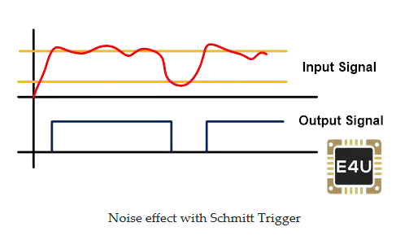
Exp. nO. 2 Schmitt trigger
The output of the Schmitt trigger remains low until the input signal crosses VUT.
Once the input signal cross this limit VUT, the output signal of the Schmitt trigger remains high until the input signal is below the level of VLT.

